Slide 1
Preparing for the Next Step in Your Career
Lisa Duffy
Program Coordinator, University Registrar, The Ohio State University

Slide 2
University Registrar
Notes:
Taking the next step in one's career isn't just about applying for a job. We need to think about the extra things we do in our roles to set us apart. Even if the next job isn't completely related to what you do now, you are gaining a set of skills (and hopefully getting opportunities above and beyond your job description - other duties as assigned!) that can help you move into a new role. Always be prepared for the next great opportunity!
This presentation wasn’t designed to think about how to set yourself apart to make yourself the best candidate for a particular job, although that is really important, too! This presentation is designed to think about how what you do on a regular basis, or what you could be doing on a regular basis, will help you prepare for the next step. Even while you are in your current job, you can be thinking about what comes next and how to set yourself up to be successful!

Slide 3
University Registrar
Notes:
NO! You don’t need to have a specific plan or even know what you’ll be doing in 5 years! It’s not a bad thing if you do have a plan or if you don’t. It’s about knowing yourself, your skills, your goals, and what you can do to get yourself there.

Slide 4
University Registrar
First Job
Hall Director – Residence Life
Ohio Dominican University
Second Job
Academic Advisor – College of Arts and Sciences and School of Communication
Ohio State University
Third Job
Program Coordinator – University Registrar
Ohio State University
Undergraduate Student
Graduate Student
Resident Assistant, Assistant Hall Director, Neighborhood Coordinator
Hope College
Hall Director, Graduate First Year Advisor
Miami University

Slide 5
7 Ways to Lay the Groundwork for Your Next Job (Even if You Don't Know What it Is)
University Registrar
From the experts
Get Out There
Stay in Touch
Build Expertise
Learn Something New
Push for Results
Figure Out Your Values
Say Yes
Notes:
I’m going to start with the experts – they know much better than I do! I don’t have formal training in career counseling or advising – it’s just a personal interest and much of what I’m going to present today comes from my experience and knowledge.
The author says that it’s ok to not have clear goals and to allow yourself to fall into opportunities.
Get Out There
Meet people, network, find ways to get involved (volunteer, attend events)
Stay in Touch
After networking, keep up with people you meet; keep up with old supervisors – people are more likely to help you if they have heard from you recently than if you don’t keep in touch
Build Expertise
Build on what you already know, find professional development opportunities, formal or informal building
Learn Something New
Take a class, learn a new set of skills, exercise your brain, even if you don’t use what you learn, you show that you can learn and you keep your brain working
Push for Results
Write down what you’ve done in your job, make more things happen for yourself so you have good material to talk about at an interview
Figure Out Your Values
Know what is important to you in your job, this will make it easier to figure what to say yes or no to
Say Yes
Do something you might have hesitated to do before, get some new experiences

Slide 6
Anticipating and Creating Career Pivots
University Registrar
From the experts
“Preparing for pivotal opportunities takes time, self-reflection and imagination.”
Do your job well and keep an eye out for new opportunities to achieve your goals
Find a position that you think you could do well
What qualifications do you need for it?
Are you ready to apply for it?
“Could this opportunity provide a pivot that puts you on the trail for making a difference?”
Notes:
Preparing for…it isn’t going to happen overnight
Do your job well…even if you are getting burned out or think you are past the time to move on, keep doing your job well. You want to continue presenting yourself as a good employee. You never know who knows someone and you never know how things might change for the better. It’s best not to burn bridges if you can avoid it.

Slide 7
Anticipating and Creating Career Pivots
University Registrar
From the experts
Who can help you? Who will advocate for you?
Take on new roles in your current job if you aren’t ready to leave
Notes:
Who can help you? Is it a boss, a co-worker, a mentor?
Take on new roles…volunteer if you have extra time, help with new student move-in, go to a campus event

Slide 8
How To Prepare For Your Dream Career While You’re In The Job You Have Now
University Registrar
From the experts
Six-step method to use your current job to help you get your next job
“Learn what you need to know”
Find out what skills you will need to do the job you want
“Create a development plan”
Make a list of what you need to do to gain the skills you will need
Do something daily or weekly to help gain these skills
“Take feedback survey”
Figure out what feedback you have been given previously and figure out what you can do to work on those pieces of information

Slide 9
How To Prepare For Your Dream Career While You’re In The Job You Have Now
University Registrar
From the experts
Six-step method to use your current job to help you get your next job
“Consult mentors and gatekeepers”
If you can, talk to your boss. If you can’t, find a mentor
“Take advantage of internal training”
Go to conferences, classes, seminars, etc.
“Volunteer”
Gain experience that doesn’t cost anyone anything
This shows your dedication and helps you get more experience in a particular area

Slide 10
Envision what comes next
University Registrar
Personal Life
Location
City/state
School/Employer
Work/life balance
Education benefits
Work Life
Higher Education
Responsibilities
Student-Centered
Supervision/ management
Skills
What are you doing this for?
Notes:
What is something you love about your current job? Something you would hate to give up if you left? Think about one thing about your office/institution and one thing about the work that you do.
Could be contact with students…or no contact with students. Could be the really good coffee or your comfortable chair
Being creative – problem solving, looking at things from a new perspective
Learning constantly
Flexibility

Slide 11
What to do now
University Registrar
Advocate for yourself
Know yourself
Myer-Briggs
True Colors
Strengths
Communicate
Be innovative
Notes:
Advocate for yourself
Think of everyday as a job interview – you are showing why you should have your job and how good you are at what you do
Know yourself
Ask yourself how your personality type can help the team? What strengths do you bring? How are you unique?
Communicate
Be known for being a great communicator.
Be innovative
Don’t always do it the same way! Find ways to make processes better. Then, write this down as an example to talk about in a job interview. Process improvements are always good examples!

Slide 12
What to do now
University Registrar
Meet a lot of people
Have a positive attitude, especially when changes happen to you
Set goals
Say yes to new opportunities
Look for professional development activities
Pull out past performance evaluations
Notes:
Meet a lot of people
In your office, on your campus, in your career field
Have a positive attitude, especially when changes happen to you
Example of what happened in ASC/Comm, with Workday
Set goals
Be strategic, work with your supervisor on setting and tracking goals (hopefully this is part of a formal evaluation process in your office)
Say yes to new opportunities
If you have the time
Look for professional development activities
Webinars, classes, conferences, etc.
Pull out past performance evaluations
Learn from what you’ve been told before

Slide 13
What to do now
University Registrar
Check job postings
Keep your résumé up-to-date
Have a plan, even if it’s not to have a plan
Notes:
What do you need to know? A certain degree? Years of experience? A particular skill set?
Who do you know?

Slide 14
Prepare for Interviews
University Registrar
Write down examples of what you have done to answer possible questions
3 “other duties as assigned” that you have done in your job
3 new things you have learned in your job
3 things you haven’t had a lot of experience with but could gain in your job
Know why your goals are your goals

Slide 15
Discussion
University Registrar
What are interview questions that you have gotten that have really thrown you off?
What is something you never thought you’d be asked to that has helped you?

Slide 16
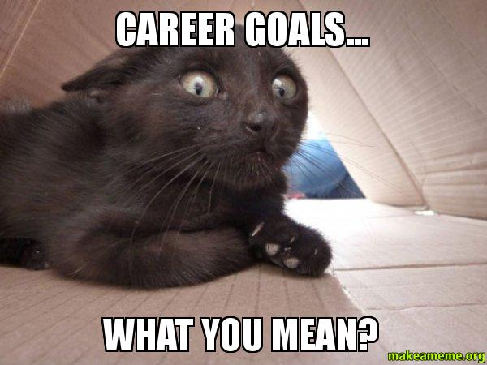
University Registrar

Slide 17
Citations
University Registrar
Moran, G. (2017, March 28). How to Prepare For Your Dream Career While You’re In The Job You Have Now. Retrieved from https://www.fastcompany.com/3069187/how-to-prepare-for-your-dream-career-while-youre-in-the-job-you-have-now
White, J. S. (2018, May 17). Anticipating and Creating Career Pivots. Retrieved from https://www.insidehighered.com/advice/2018/05/17/how-create-opportunities-pivot-your-career-opinion
Zhang, L. (???). 7 Ways to Lay the Groundwork for Your Next Job (Even if You Don’t Know What it Is). Retrieved from https://www.themuse.com/advice/7-ways-to-lay-the-groundwork-for-your-next-job-even-if-you-dont-know-what-it-is

